Slide 1

Malignant Comment Prediction
By
Gargi Saha Samanta

Slide 2

Content
Problem Statement
Data Summary
Data Preprocessing
Exploratory Data Analysis
Feature Engineering
Model Building with Classification techniques
Hypertuning the Best Model
Conclusion

Slide 3
Problem Statement
The proliferation of social media enables people to express their opinions widely online. However, at the same time, this has resulted in the emergence of conflict and hate, making online environments uninviting for users.
Although researchers have found that hate is a problem across multiple platforms, there is a lack of models for online hate detection. Online hate, described as abusive language, aggression, cyberbullying, hatefulness and many others has been identified as a major threat on online social media platforms. Social media platforms are the most prominent grounds for such toxic behaviour.
There has been a remarkable increase in the cases of cyberbullying and trolls on various social media platforms. Many celebrities and influences are facing backlashes from people and have to come across hateful and offensive comments. This can take a toll on anyone and affect them mentally leading to depression, mental illness, self-hatred and suicidal thoughts.
Internet comments are bastions of hatred and vitriol. While online anonymity has provided a new outlet for aggression and hate speech, machine learning can be used to fight it.
The problem we sought to solve was the tagging of internet comments that are aggressive towards other users. This means that insults to third parties such as celebrities will be tagged as unoffensive, but “u are an idiot” is clearly offensive.
Our goal is to build a prototype of online hate and abuse comment classifier which can used to classify hate and offensive comments so that it can be controlled and restricted from spreading hatred and cyberbullying.

Slide 4

Data Summary
FEATURES:
Malignant: It is the Label column, which includes values 0 and 1, denoting if the comment is malignant or not.
Highly Malignant: It denotes comments that are highly malignant and hurtful.
Rude: It denotes comments that are very rude and offensive.
Threat: It contains indication of the comments that are giving any threat to someone.
Abuse: It is for comments that are abusive in nature.
Loathe: It describes the comments which are hateful and loathing in nature.
ID: It includes unique Ids associated with each comment text given.
Comment text: This column contains the comments extracted from various social media platforms.

Slide 5
Data Preprocessing
Convert to lower
Replace email address
Replace web address
Replace money symbols
Replace 10 digit phone numbers (formats include paranthesis, spaces, no spaces, dashes) with 'phonenumber’
Replace numbers with 'numbr’
Finding the stopwords.
Applying lemmatization.
Analyzing of loud words which are offensive, hurting and not acceptable

Slide 6
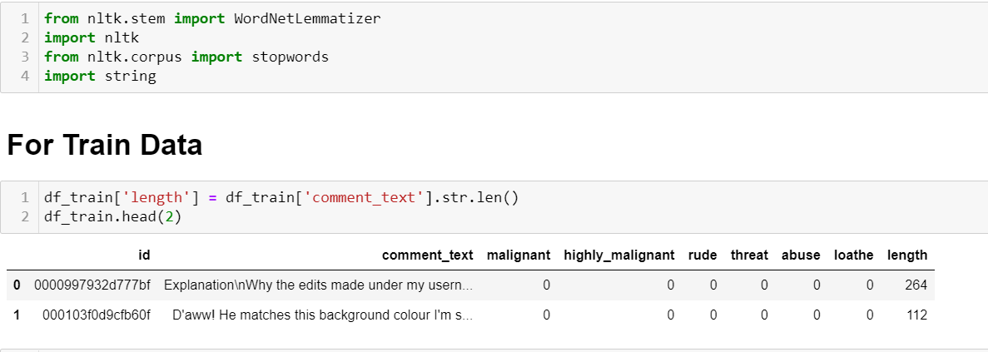
Data Preprocessing

Slide 7
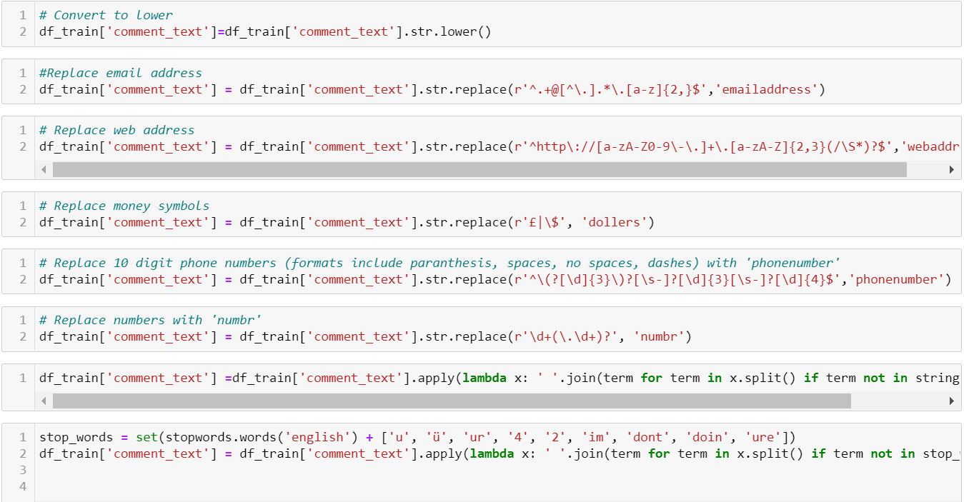

Slide 8
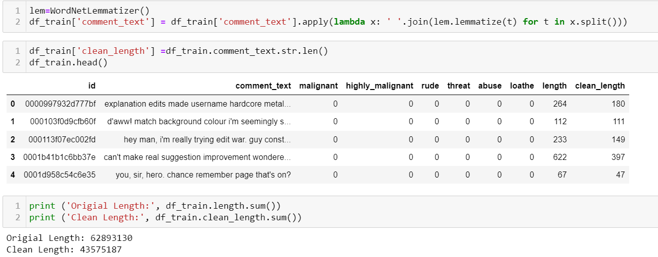

Slide 9
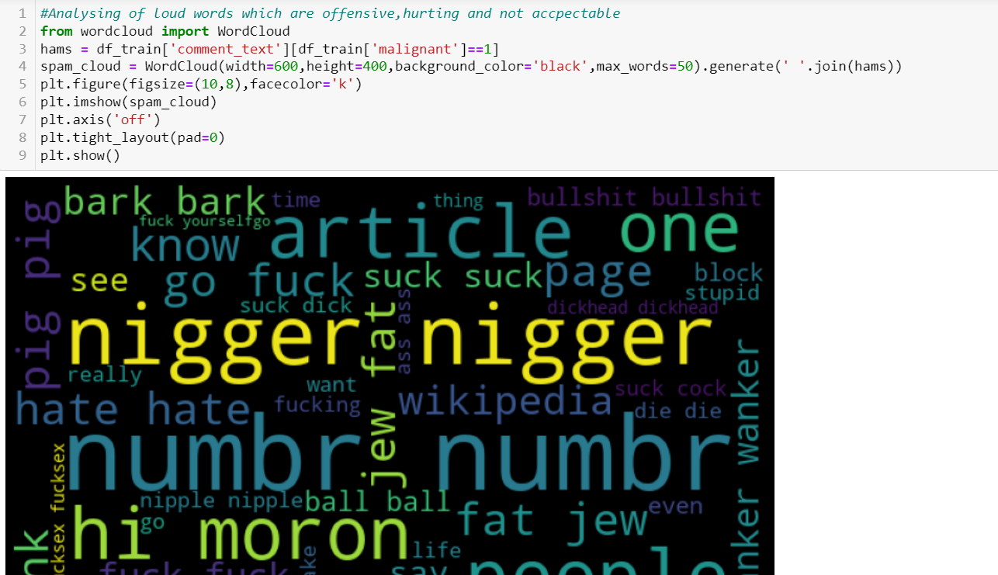

Slide 10
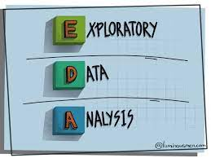
Exploratory Data Analysis ( EDA)

Slide 11
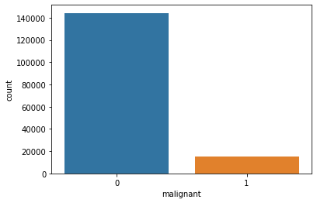
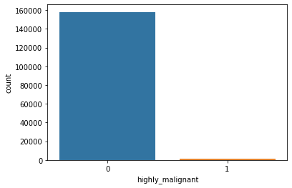
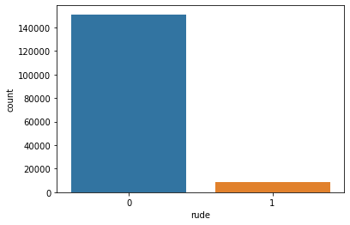
Univariate Analysis of categorical variables
Observation:
The malignant,highly malignant and rude data are highly imbalaced and seems that there are not much comments with loud data.
Malignant data are most as compared to rude and highly malignant data.

Slide 12
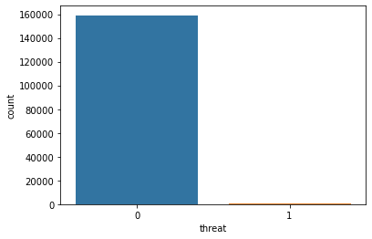
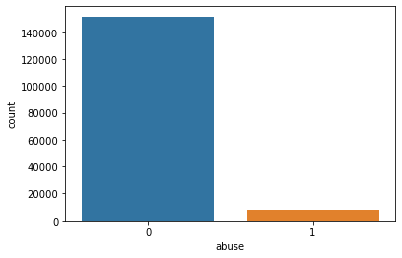

Univariate Analysis of Numerical variables
OBSERVATION:
Similarly for threat,abuse and loathe also data are highly imbalaced and seems that there are not much comments with loud data.
Abusive data are more than threat or loathe.

Slide 13
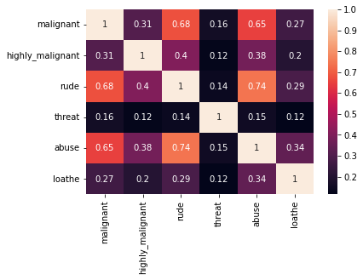
Observation: Malignant, rude and abusive words are highly correlated words for my dataset.

Slide 14
Models used:
LogisticRegression()
DecisionTreeClassifier()
KNeighborsClassifier()
RandomForestClassifier()
AdaBoostClassifier()
XGBClassifier()

Slide 15
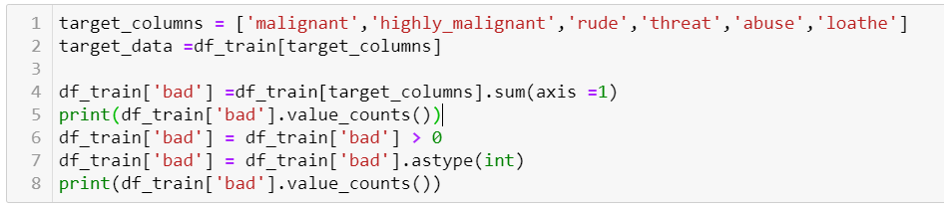
Model Building
From the dataset we can infer that it is clearly a MulticlassClassification problem.

Slide 16
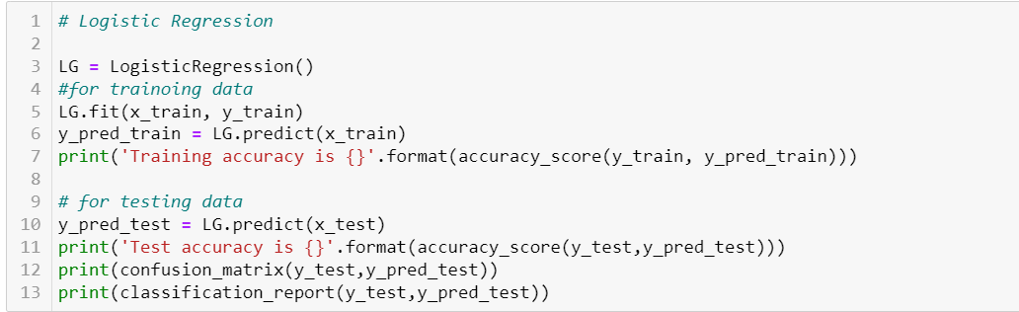
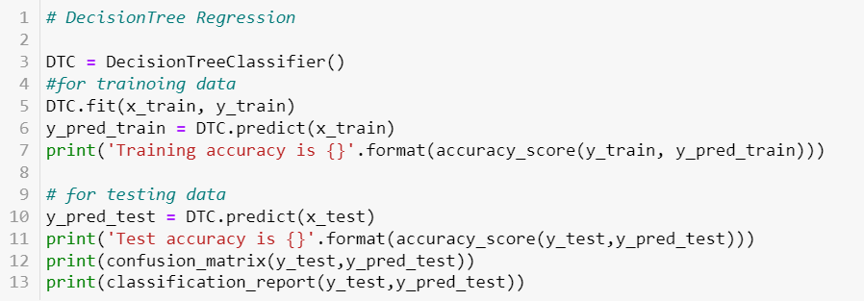
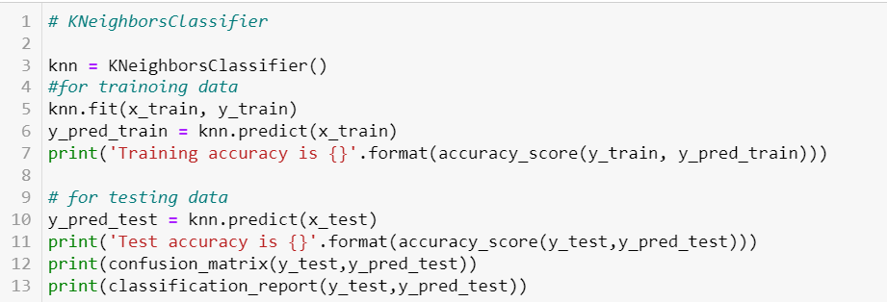
Fitting The Model

Slide 17
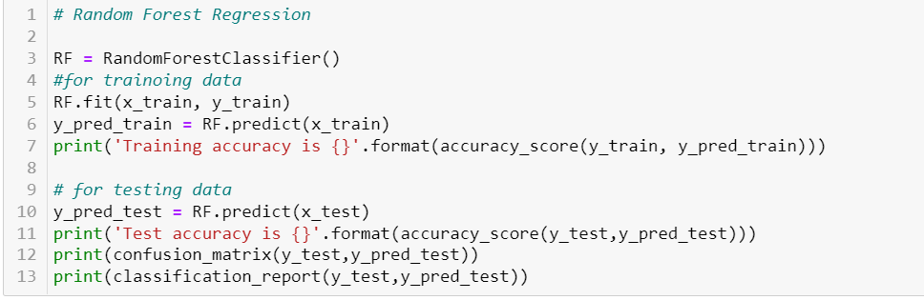
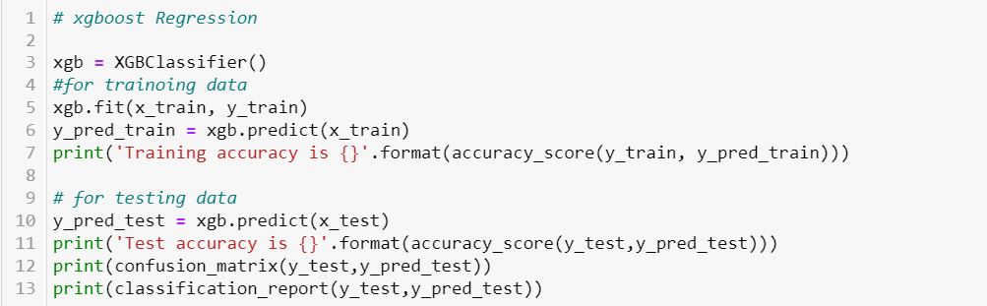
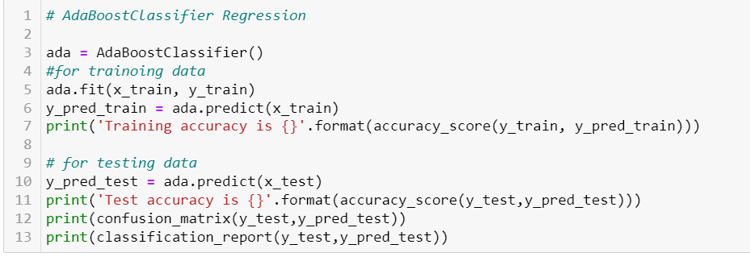
Fitting The Model

Slide 18
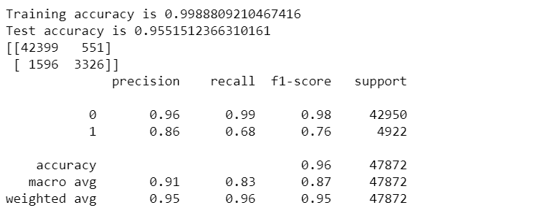
Accuracy of the Best Model (Random Forest Classifier)

Slide 19
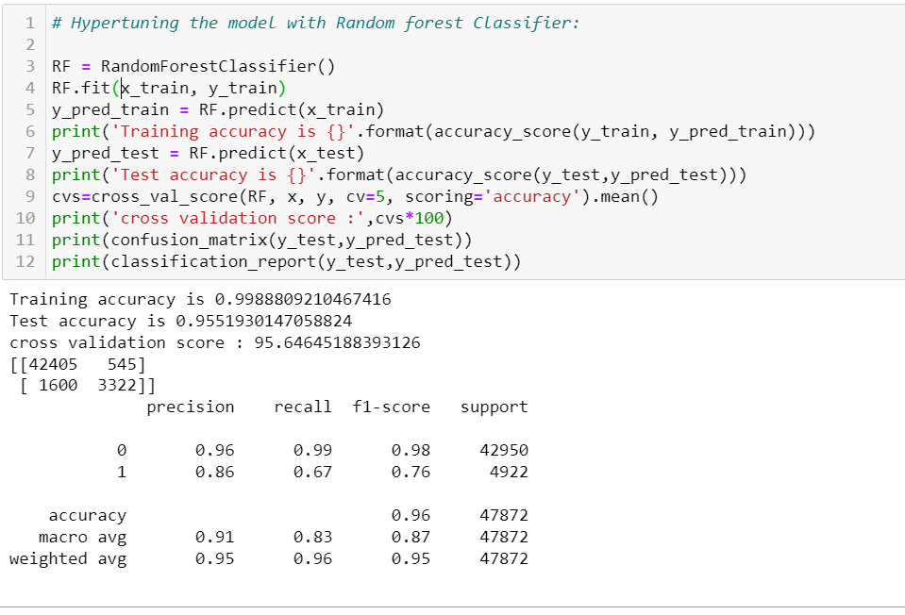
Best Model

Slide 20
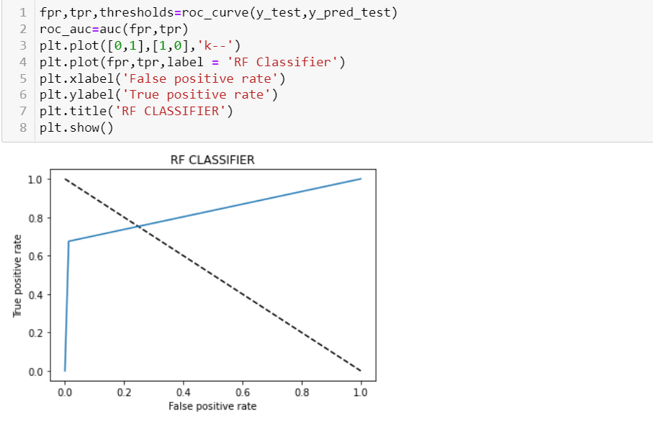
ROC _AUC CURVE

Slide 21
CONCLUSION
FINAL OBSERVATION:
Finally we have saved the Random Forest Classifier Model.

Slide 22


